Slide 1


Slide 2

BANGLADESH UNIVERSITY OF BUSINESS AND TECHNOLOGY (BUBT)
Fariya Ahmed
ID: 20211203017
Md. Nabil Rahman
ID: 20211203047
Shanto Sikder
ID: 20211203048
Mosharof Parves
ID: 20211203050
Md. Amzad Hosen
ID: 20211203053

Slide 3
Supervised by :
Md. Saddam Hossain
Lecturer, Department of C.S.E
Bangladesh University of Business and Technology (BUBT)

Slide 4
INTRODUCTION
This is a simple Hospital Management System project.
User friendly.
User login page where user can find Doctor Information, and Doctor Booking Information.

Slide 5
KEY FEATURES
Add Patients and Doctors.
View all available Patients and Doctors in your Hospital.
Delete Patients .
Search Patients ,if you need any one.
Admin panel and user panel.

Slide 6
REQUIRMENT ANALYSIS
Software requirement:
Code Editor –
Code::Blocks(Recommendation)
Programming language – C++
Compiler - GCC compiler 6.3.0
Hardware requirement:
A PC with any version of Windows installed.
Processor : 1GHz (recommended)
Ram : 512 MB ( Minimum)
Disk : 1 GB (will be suﬃcient)

Slide 7
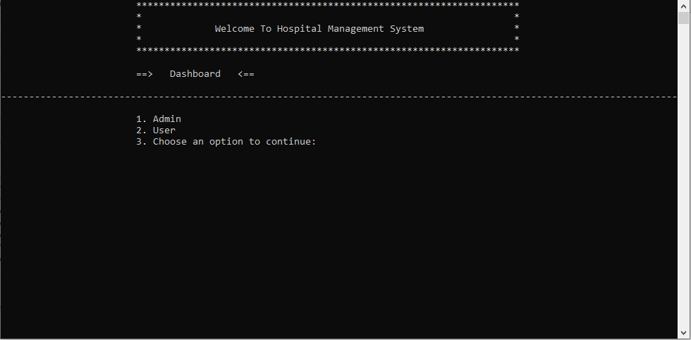
Home page

Slide 8
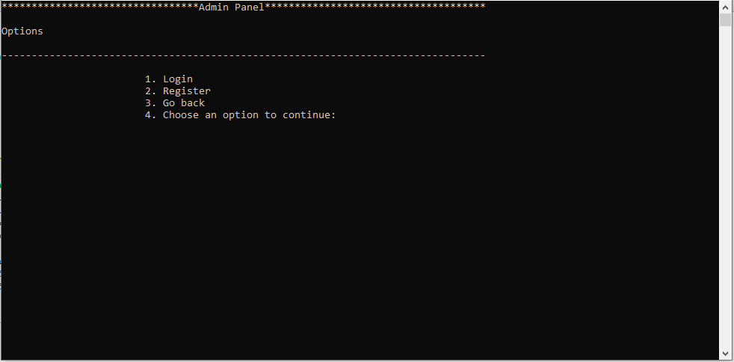
Admin panel

Slide 9
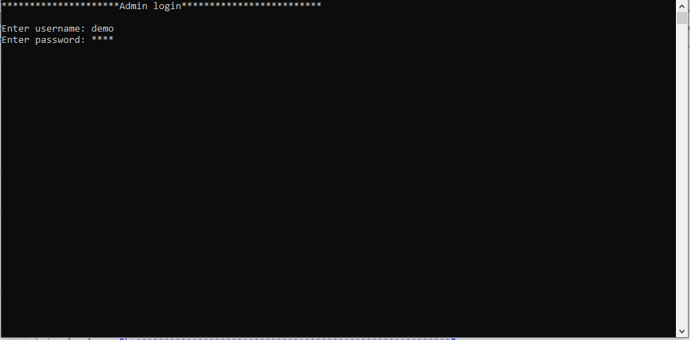
Admin Panel - Admin panel is made for administrative purpose . If username and password wrong then try again.

Slide 10
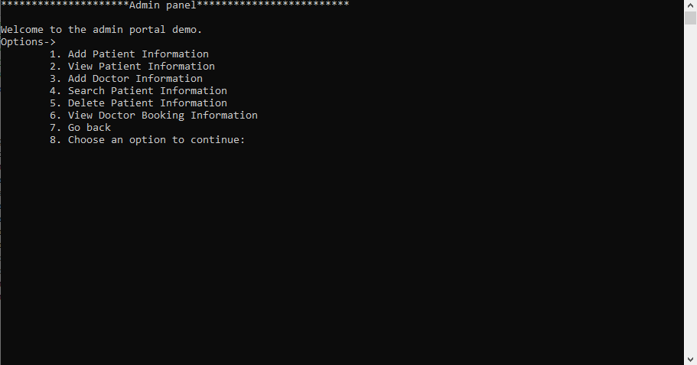
Admin Panel –
Main Menu

Slide 11
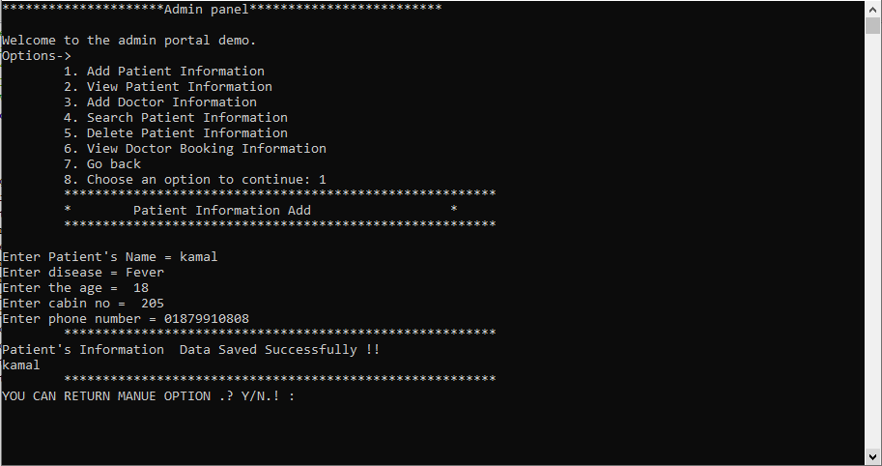
Admin Panel –
Add patient

Slide 12
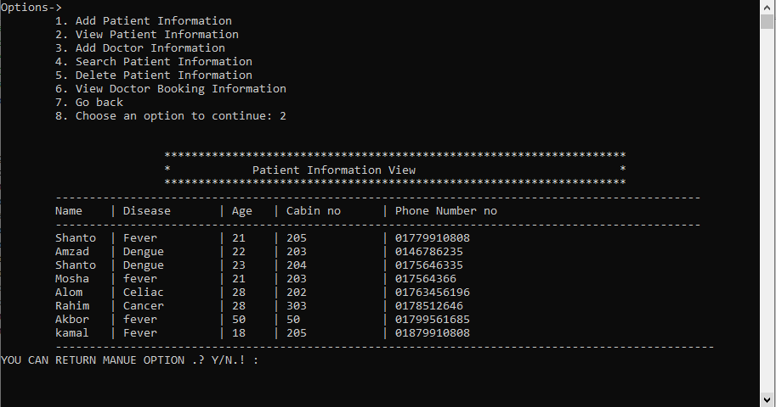
Admin Panel – patient view

Slide 13
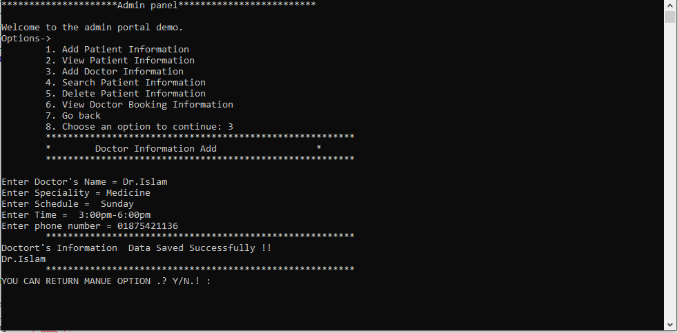
Admin Panel – Add New Doctor.

Slide 14
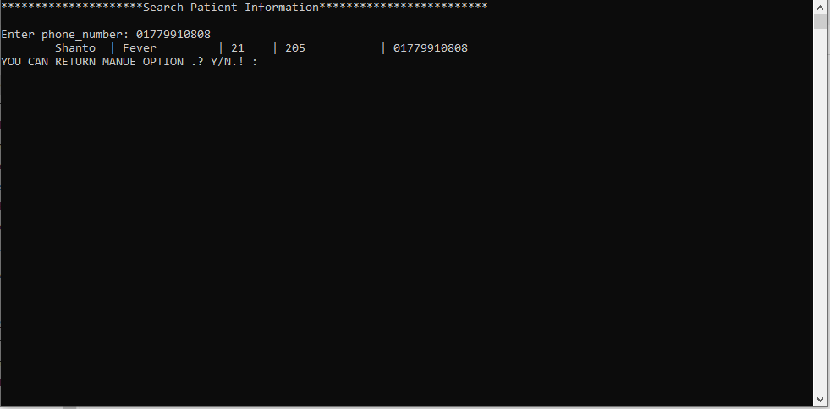
Admin Panel – Search patient information

Slide 15
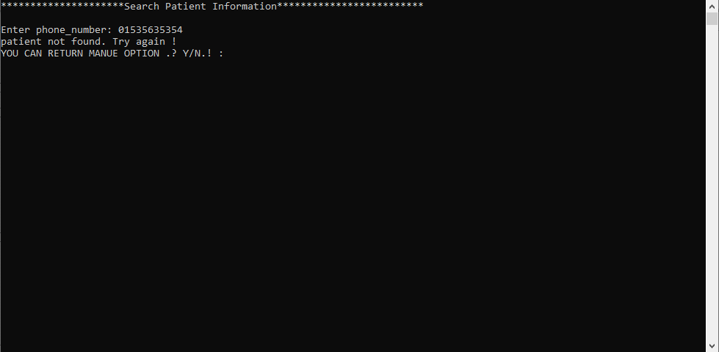
Admin Panel – Search patient .
If id don’t match with file then patient not found.

Slide 16
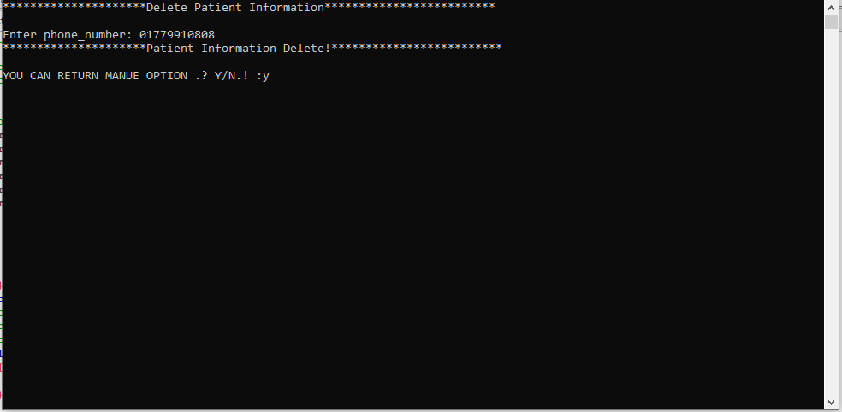
Admin Panel –
Delete patients.

Slide 17
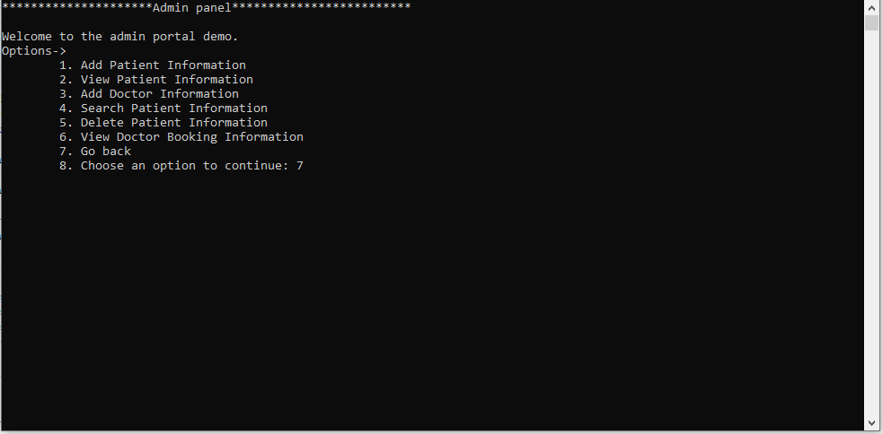
Admin Panel – Go Back .

Slide 18
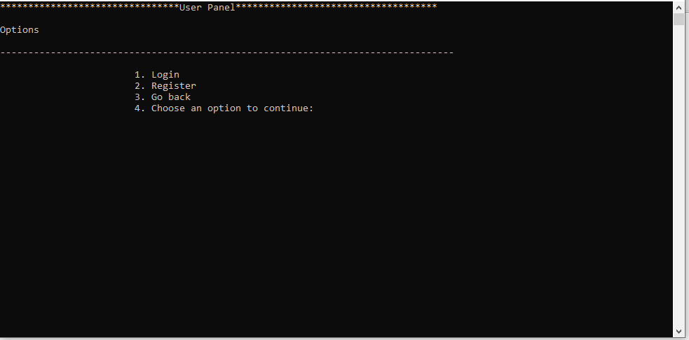
User Panel –
User Home Page.

Slide 19
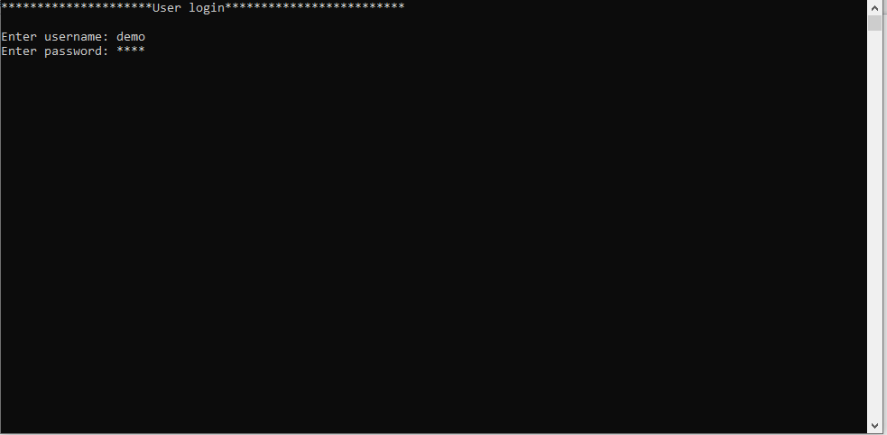
User Panel –
User log in.

Slide 20
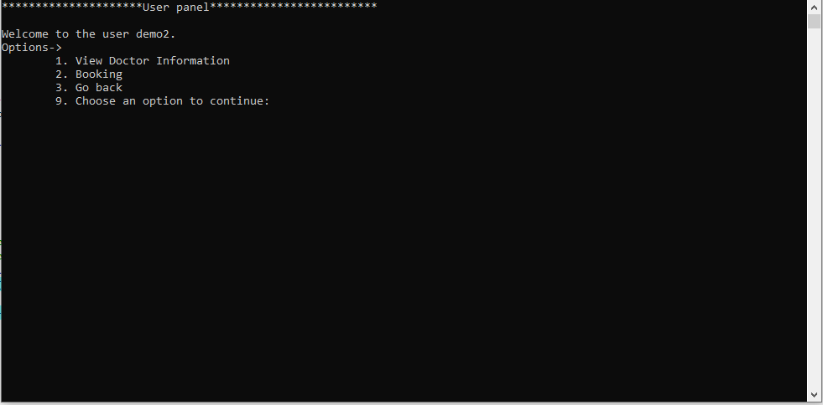
User Panel –
Main Menu

Slide 21
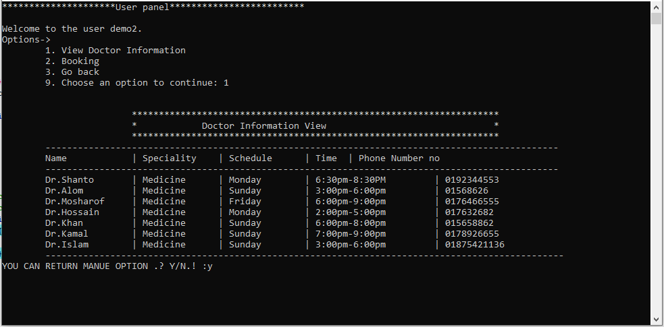
User Panel– View Doctor information

Slide 22
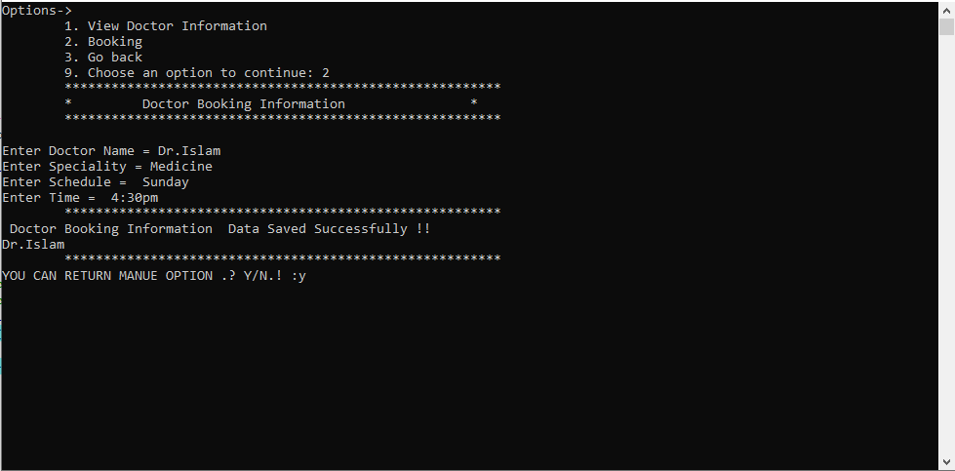
User Panel–
Doctor Booking

Slide 23
Thanks You all

